Slide 1


AI-powered Crop’s Health Detection
BY:
AAYUSH SHARMA
BHARAT SIGH RATHOD
SHIVAM
RAJAN THAKUR

Slide 2
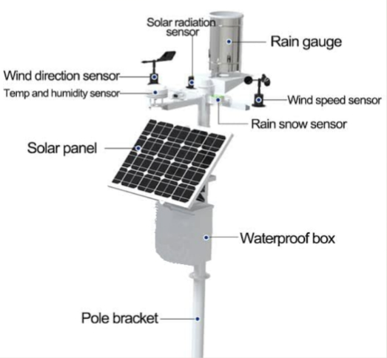
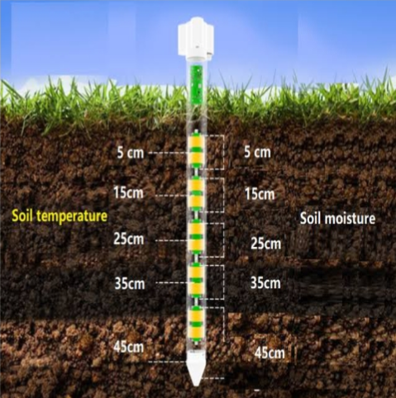
CropDoc
.
.

Slide 3
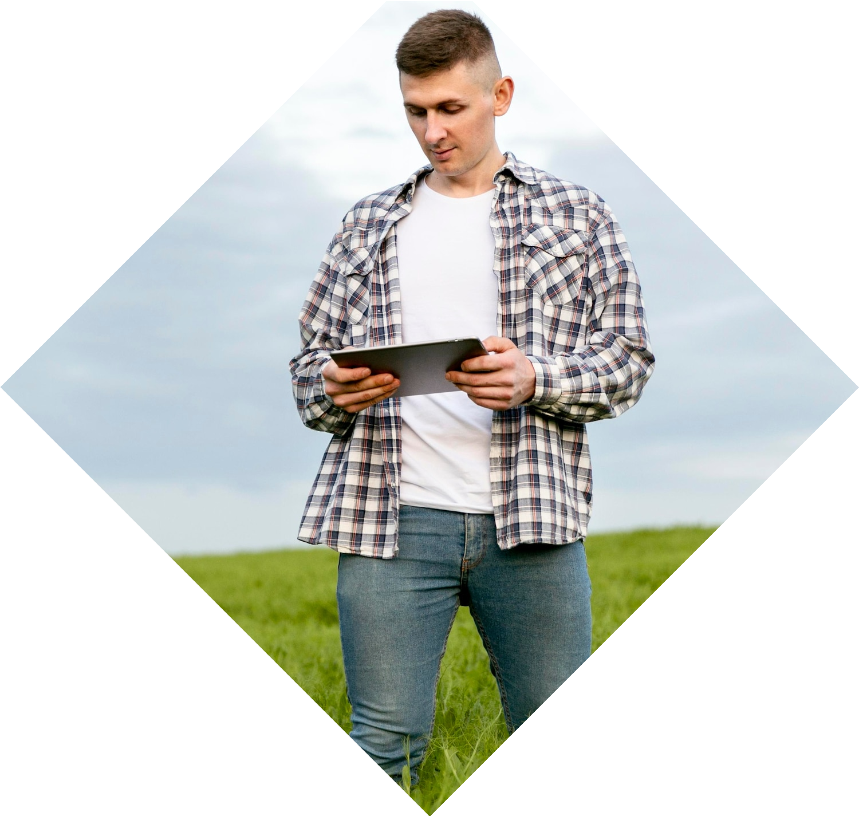
Introduction
The agriculture industry is ripe for innovation.
This proposal aims to inegrate health monitoring
and medical services for crops through
Mobile apps. This revlolution will enhance productivity
and sustainability.

Slide 4
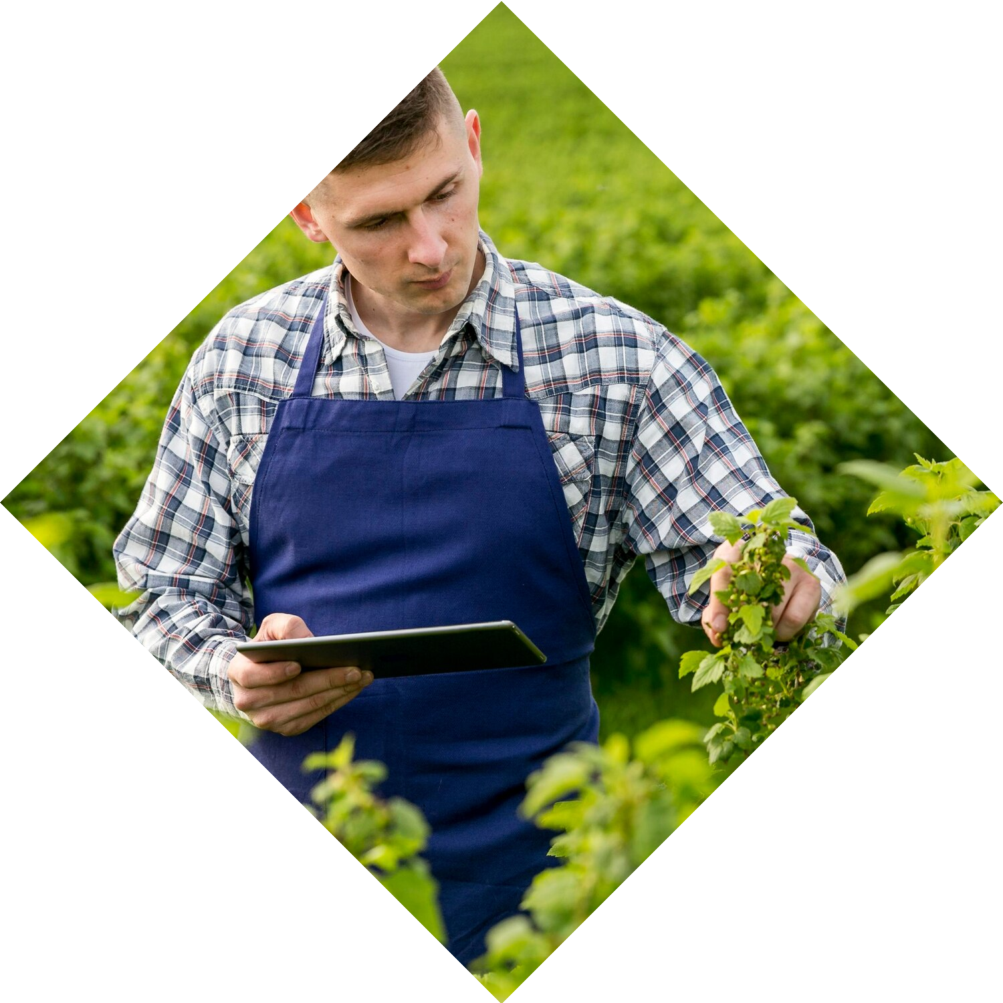
Current Challenges
PROJECT GOALS:
Develop an AI system to analyze crop images and detect potential health problems.
Recommend appropriate treatments based on the identified issue.
Empower farmers with data-driven insights for improved decision-making.

Slide 5
Current Challenges
PROBLEM :
Current Challenges: Farmers rely on visual inspection, often lacking expertise to diagnose issues early

Slide 6
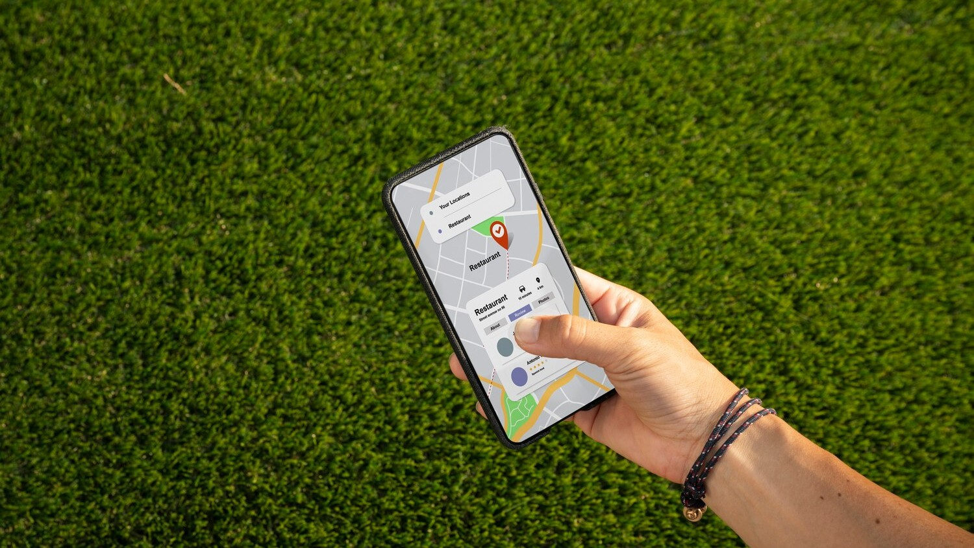
Proposed Solution
sdd
Introducing a mobile application for real-time monitoring of crop health.

Slide 7
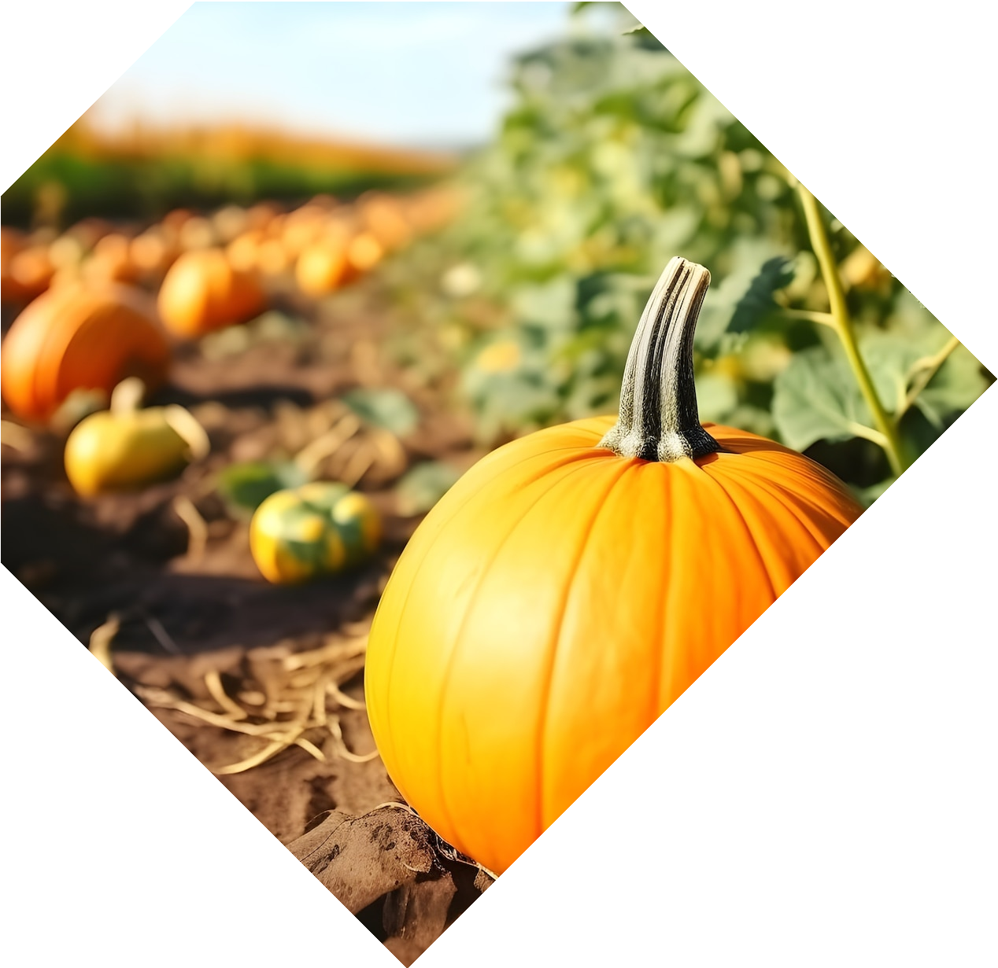
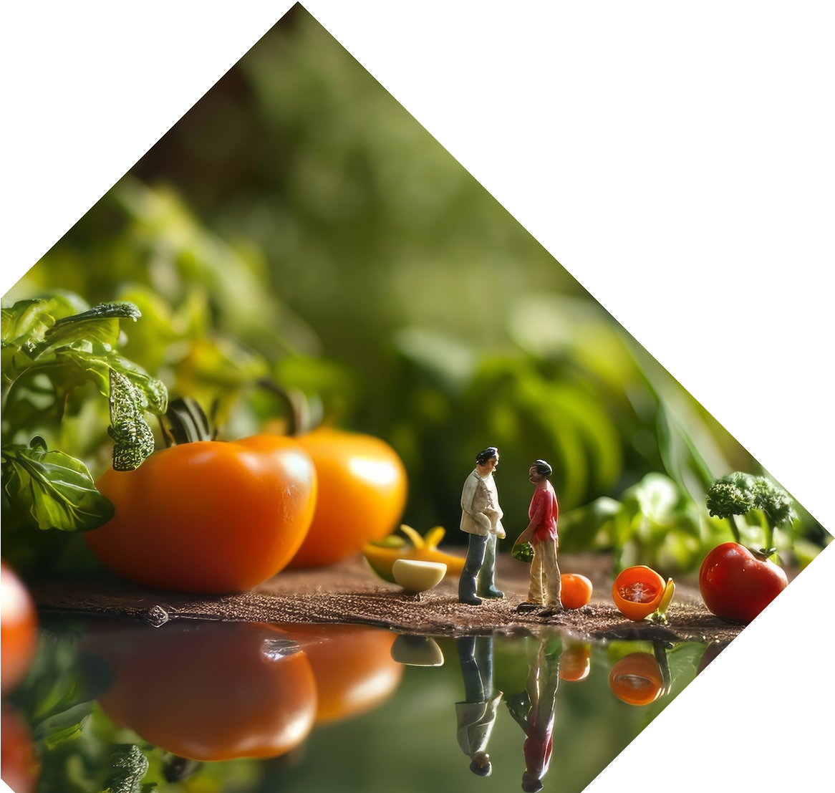
How it going to solve?
Image Acquisition: Farmers capture crop images using smartphones or specialized cameras.
AI Analysis: Deep learning algorithms analyze images, trained on a vast dataset of healthy and diseased crops.
Precise Detection: The system identifies potential diseases and nutrient deficiencies.
Treatment Recommendations: Based on the issue, the system suggests appropriate treatments.

Slide 8

USER INTERFACE
Mobile App or Web Interface: Easy access for farmers in the field.
Simple Image Upload: User-friendly interface for capturing crop images.
Clear Results: Concise display of detected issues and recommended treatments.

Slide 9
Why this app?
User-friendly
Enhancing the productivity
Moving in a scientific ways.
Accuracy

Slide 10

Future Prospects
Global Impact: Contribution to global food security through optimized resource use and sustainable agriculture practices.
Policy Support: Anticipated policy support and regulation to promote responsible adoption and investment in agricultural innovation.
.
.

Slide 11
Market Impact
Market Expansion: The adoption of the Crop Health Monitoring and Medical Suggestions System will contribute to the expansion of the agricultural technology market, driven by increasing demand for precision farming solutions.
Product Diversification: The system's integration into existing agricultural technology portfolios will enhance product offerings and diversify revenue streams for agritech firms.

Slide 12

PROJECT TIMELINE
Data Collection (images)
AI Model Training and Development
System Testing and Refinement
User Interface Development
Mobile App/Web Platform Development (if applicable)

Slide 13
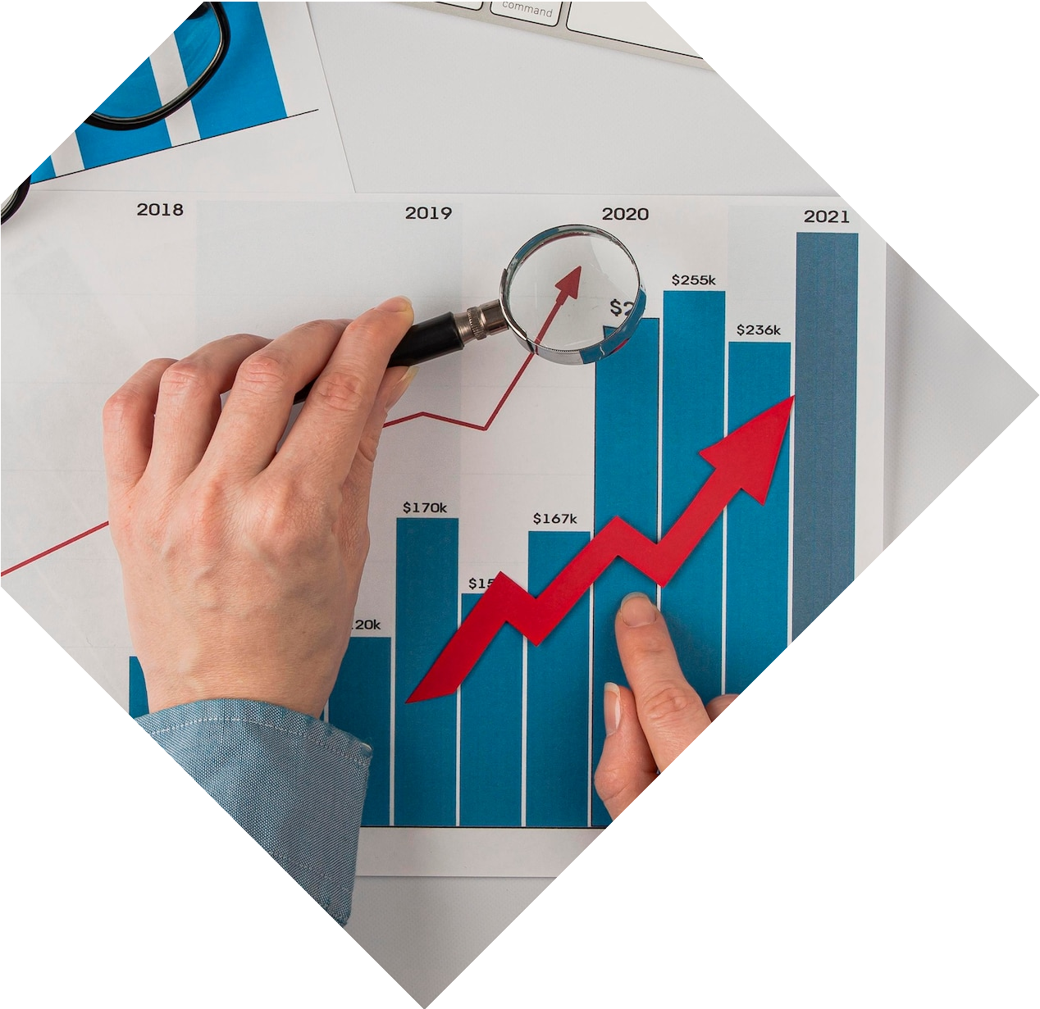

Financial Considerations
Data Acquisition Costs (if purchasing images)
AI Development Tools and Resources (cloud computing, software licenses)
Mobile App/Web Platform Development Costs (if applicable)
User Testing and Feedback Incorporation

Slide 14







Conclusion
The integration of and
for crops through
presents a significant opportunity
. This will lead to
, , and
for
.

Slide 15
Thanks!
Do you have any questions?

